Slide 1
Digital Thinking and Innovation
Digital Currencies and Blockchain

Slide 2

Introduction
This topic discusses the current trend of digital currencies and blockchain.

Slide 3
Learning Outcomes for the Lecture
At the end of this lecture you will be able to:
Explain digital currency
Explain cryptocurrency
Provide the advantages and cons of cryptocurrency
Explain the blockchain, bitcoin, and mining
Discuss the Present and Future of Digital Currency

Slide 4
Content
Digital Currency
Advantages of Digital Currency
Cryptocurrency
Advantages and Cons of Cryptocurrency
Blockchain
Bitcoin
Miners
The Present and Future of Digital Currency

Slide 5
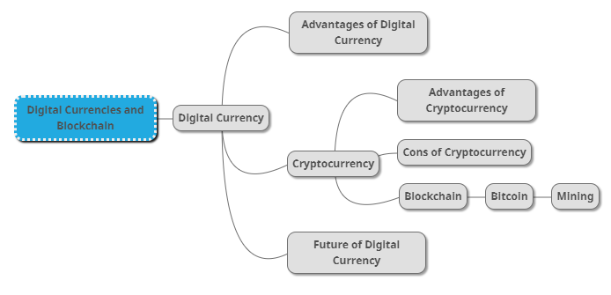
Mind Map

Slide 6
Learning Outcomes for the Lecture
At the end of this lecture, you will be able to:
Explain digital currency
Explain cryptocurrency
Provide the advantages and cons of cryptocurrency
Explain the blockchain, bitcoin, and mining
Discuss the Present and Future of Digital Currency

Slide 7
Digital Currency
Digital currencies or e-money, are now more popular than ever
They fill all the uses of traditional forms of money
Only exist on the internet, and is completely intangible
Every aspect of their issuance, transfer, and record-keeping is digital

Slide 8
Advantages of Digital Currency
Provide users with a more streamlined alternative
Peer-to-peer transactions
Digital currency payments are both instantaneous and low-cost
Introduce a higher level of record-keeping and transparency to the sector

Slide 9
Recap
What is e-money?
What are the advantages of digital currencies?

Slide 10
Recap
What is e-money?
Digital currencies
They fill all the uses of traditional forms of money
Only exist on the internet, and is completely intangible
Every aspect of their issuance, transfer, and record-keeping is digital
What are the advantages of digital currencies?
more streamlined alternative
Peer-to-peer transactions
Transactions are instantaneous and low-cost
higher level of record-keeping and transparency to the sector

Slide 11
Learning Outcomes for the Lecture
At the end of this lecture you will be able to:
Explain digital currency
Explain cryptocurrency
Provide the advantages and cons of cryptocurrency
Explain the blockchain, bitcoin, and mining
Discuss the Present and Future of Digital Currency

Slide 12
What is Cryptocurrency
Let’s look into this video related to cryptocurrency:
https://youtu.be/6Gu2QMTAkEU (this video is obsolete)

Slide 13
Cryptocurrency
Digital currencies encountered a problem known as “double-spend”
This issue saw resolution with the introduction of the world’s first Cryptocurrency – Bitcoin.
Cryptocurrency makes it nearly impossible to counterfeit or double-spend
Many cryptocurrencies are decentralized networks based on blockchain technology

Slide 14
Learning Outcomes for the Lecture
At the end of this lecture you will be able to:
Explain digital currency
Explain cryptocurrency
Provide the advantages and cons of cryptocurrency
Explain the blockchain, bitcoin, and mining
Discuss the Present and Future of Digital Currency

Slide 15
Advantages of Cryptocurrency
Built-in Scarcity May Support Value
Cryptocurrencies are more like precious metals than fiat currencies. Like precious metals, they may offer inflation protection unavailable to fiat currency users
Loosening of Government Currency Monopolies
Offer a reliable means of exchange outside the direct control of national banks’ quantitative easing (central banks’ “printing money” by purchasing government bonds)

Slide 16
Advantages of Cryptocurrency
Self-Interested, Self-Policing Communities
Because miners are paid for their efforts, they have a financial stake in keeping accurate, up-to-date transaction records – thereby securing the integrity of the system and the value of the currency
Robust Privacy Protections
Many cryptocurrency users employ pseudonyms unconnected to any information, accounts, or stored data that could identify them

Slide 17
Advantages of Cryptocurrency
Harder for Governments to Exact Financial Retribution
Governments can freeze or seize domestic bank accounts, or reverse transactions made in local currency. Cryptocurrencies are virtually immune from authoritarian caprice
Fewer Barriers and Costs to International Transactions
Cryptocurrencies don’t treat international transactions any differently than domestic transactions. Transactions are either free or come with a nominal transaction fee, no matter where the sender and recipient are located.

Slide 18
Advantages of Cryptocurrency
Generally Cheaper Than Traditional Electronic Transactions
Eliminate the need for a third-party payment processor – such as Visa or PayPal – to authenticate and verify every electronic financial transaction, hence eliminating the need for mandatory transaction fees.
Miners, the cryptocurrency equivalent of payment processors, earn new currency units for their work in addition to optional transaction fees.
Cryptocurrency transaction fees are generally less than 1% of the transaction value, versus 1.5% to 3% for credit card payment processors and PayPal

Slide 19
Cons of Cryptocurrency
Lack of Regulation Facilitates Black Market Activity
Many gray and black-market online transactions are denominated in Bitcoin and other cryptocurrencies
Potential for Tax Evasion in Some Jurisdictions
Since cryptocurrencies aren’t regulated by national governments and usually exist outside their direct control, they naturally attract tax evaders

Slide 20
Cons of Cryptocurrency
Potential for Financial Loss Due to Data Loss
The infrastructure may be robust, but humans are the weakest link. Cryptocurrency users may not take the proper precautions to avoid data loss
Potential for High Price Volatility and Manipulation
Many cryptocurrencies have relatively few outstanding units concentrated in a handful of individuals’ (often the currencies’ creators and close associates) hands. These holders effectively control these currencies’ supplies, making them susceptible to wild value swings and outright manipulation

Slide 21
Cons of Cryptocurrency
Often Can’t Be Exchanged for Fiat Currency
Only the most popular cryptocurrencies – those with the highest market capitalization, in dollar terms – have dedicated online exchanges that permit direct exchange for fiat currency
Limited to No Facility for Chargebacks or Refunds
Although cryptocurrency miners serve as quasi-intermediaries for cryptocurrency transactions, they’re not responsible for arbitrating disputes between transacting parties. This means that you have no one to appeal to if you’re cheated in a cryptocurrency transaction

Slide 22
Cons of Cryptocurrency
Adverse Environmental Impacts of Cryptocurrency Mining
Cryptocurrency experts acknowledge that mining presents a serious environmental threat at current rates of growth
Refer to slide 26

Slide 23
Digital Currency Vs. Cryptocurrency
Cryptocurrency includes:
Bitcoin
Litecoin
Ripple
Etherium
Dogecoin
Coinye

Slide 24
Recap
What are the upsides and downsides of cryptocurrency?
Upsides
No govt monopoly
Scarce

Slide 25
Learning Outcomes for the Lecture
At the end of this lecture you will be able to:
Explain digital currency
Explain cryptocurrency
Provide the advantages and cons of cryptocurrency
Explain the blockchain, bitcoin, and mining
Discuss the Present and Future of Digital Currency

Slide 26
Blockchain
Blockchain is the master ledger that records and stores all prior transactions and activity, validating ownership of all units of the currency at any given point in time
It records the entire transaction history to date
A blockchain has a finite length, containing a finite number of transactions that increases over time
A cryptocurrency transaction isn’t finalized until it’s added to the blockchain; once the transaction is finalized, it’s usually irreversible

Slide 27
Blockchain
A blockchain is a peer-to-peer system with no central authority managing data flow
It has a large distributed network of independent users in more than one location, referred to as full nodes
To prevent the network from being corrupted, blockchain networks produce cryptocurrencies as an incentive to maintain the integrity of the network

Slide 28
Blockchain
Blockchains originated with the creation of Bitcoin
The original Bitcoin network was built to secure the Bitcoin cryptocurrency
Around 5,000 full nodes and is globally distributed
Primarily used to trade Bitcoin and exchange value
Being used to secure other smaller blockchains and blockchain applications.

Slide 29

Group Discussion
Watch and discuss the content of the video:
https://www.youtube.com/watch?v=SSo_EIwHSd4

Slide 30
Bitcoin
Bitcoin marked a change in financial theory within the market
A medium of exchange
A unit of account
A store of value
Additionally, Bitcoin was
Scarce
Unduplicable
Portable

Slide 31
Bitcoin
Solved the double-spend issue through the integration of timestamped cryptographic blocks
Utilizes part of the time stamp in the hashing algorithm of the following block
Bitcoin became the first immutable and unalterable digital currency in existence
A hacker would need to redo the entire blockchain to alter it

Slide 32
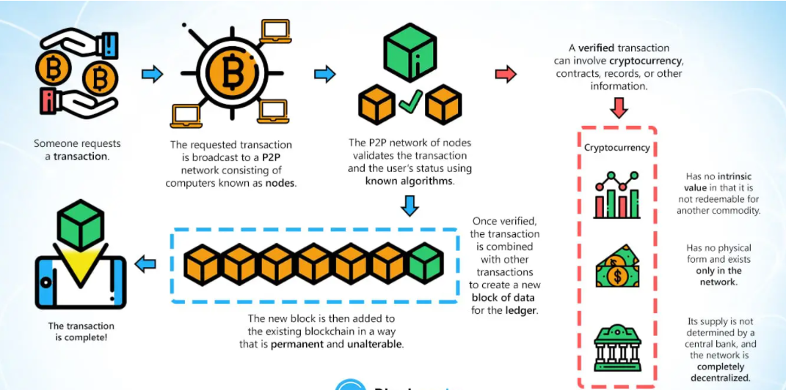
Bitcoin
Bitcoin Transaction Process Flow

Slide 33
Group Discussion
Watch and discuss the content of the video:
https://www.youtube.com/watch?v=s4g1XFU8Gto

Slide 34
Miners
Miners serve as record-keepers for cryptocurrency communities, and indirect arbiters of the currencies’ value
Using vast amounts of computing power, miners use highly technical methods to verify the completeness, accuracy, and security of currencies’ block chains

Slide 35
Group Discussion
Watch and discuss the content of the video:
https://www.youtube.com/watch?v=GmOzih6I1zs

Slide 36
Learning Outcomes for the Lecture
At the end of this lecture you will be able to:
Explain digital currency
Explain cryptocurrency
Provide the advantages and cons of cryptocurrency
Explain the blockchain, bitcoin, and mining
Discuss the Present and Future of Digital Currency

Slide 37
The Present and Future of Digital Currency
Today, there is a robust digital infrastructure in place to support the mass adoption of these currencies
Additionally, their development is being catapulted into the spotlight thanks to the Coronavirus pandemic
This trend is expected to continue as more people across the world gain access to high-speed internet
For now, digital currencies such as Bitcoin continue to reshape the international communities’ definition of money.

Slide 38
The Present and Future of Digital Currency
Recognizing the technological advantages of blockchain technology, Central Bankers are now major players in the cryptocurrency space
However, unlike Bitcoin, CBDC features a centralized distributed ledger technology (DLT)
Allows the central bankers to issue and control the monetary supply in a manner similar to the current fiat currency system in place.

Slide 39
The Present and Future of Digital Currency
Today, multiple countries, have plans to issue digital currencies in the coming years.
Russia, India, Uruguay, England, and Sweden all announced digital currency initiatives
Many other countries to follow in the future

Slide 40
Summary
Digital Currency
Advantages of Digital Currency
Cryptocurrency
Advantages and Cons of Cryptocurrency
Blockchain
Bitcoin
Miners
The Present and Future of Digital Currency

Slide 41
Questions and Answer
Q & A

Slide 42

Next Lecture
Digital Security

